Slide 1
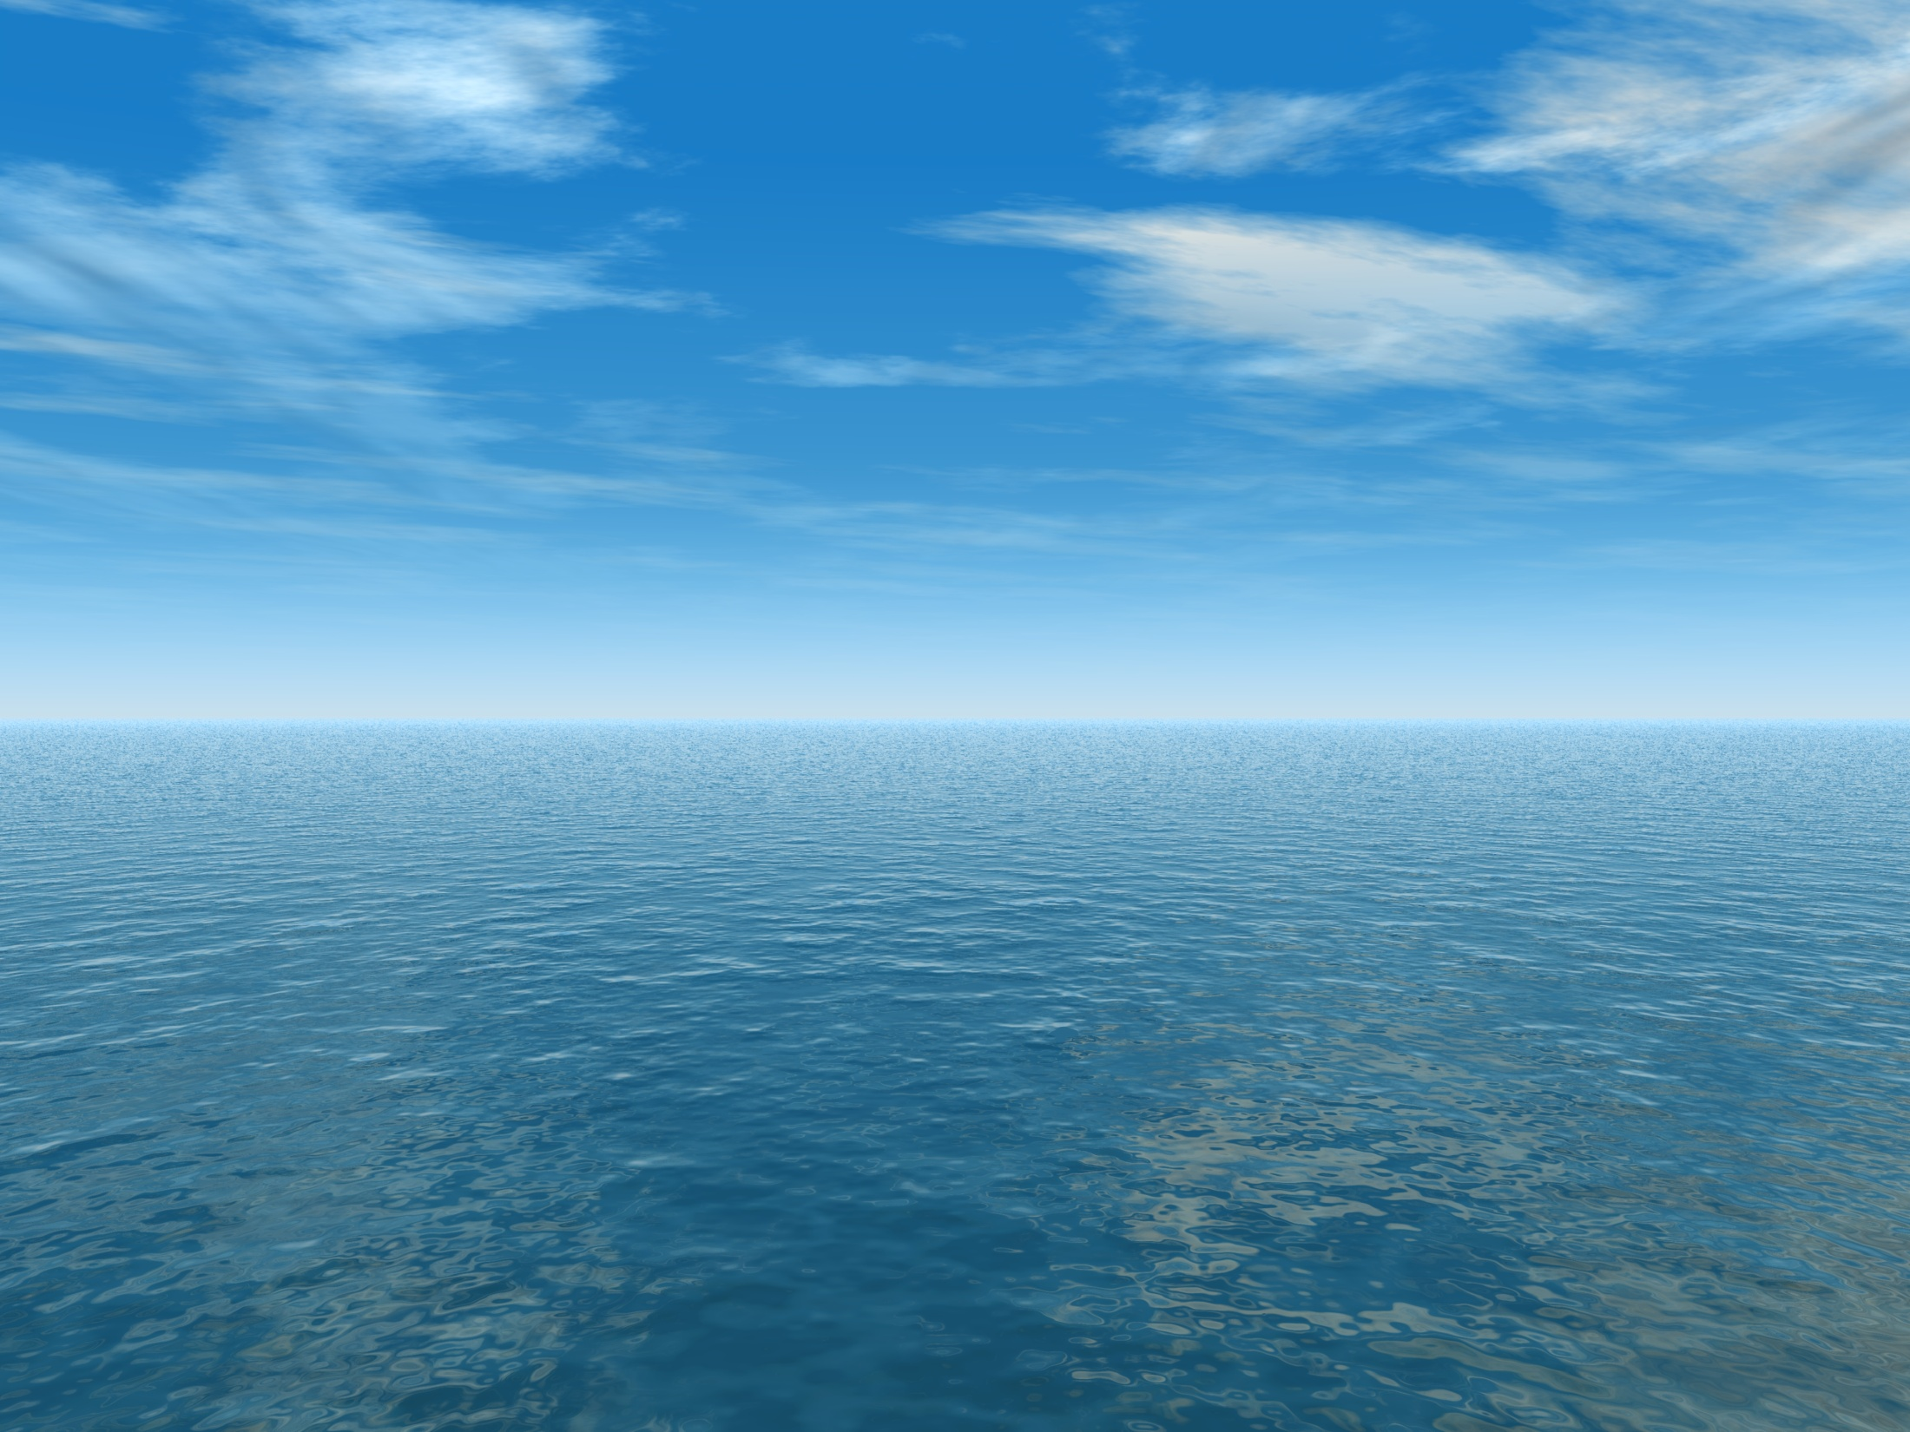
THE AQUANTIS OCEAN-CURRENT TURBINE
RENEWABLE ENERGY FROM MARINE CURRENTS
Tow Tank Model Rotor
Rotational Flow Investigation
April 16, 2013
Henry Swales
Company Confidential and Proprietary

Slide 2
Rotational Flow Effects
Primary Drivers:
Solidity (Chord vs. Radius)
Match TSR & Cl
Post-Stall Performance
Match Hydrofoils & Re#
May be possible to design model rotor to have full-scale solidity, but post-stall performance is very different due to Re# difference and hydrofoil selection.

Slide 3
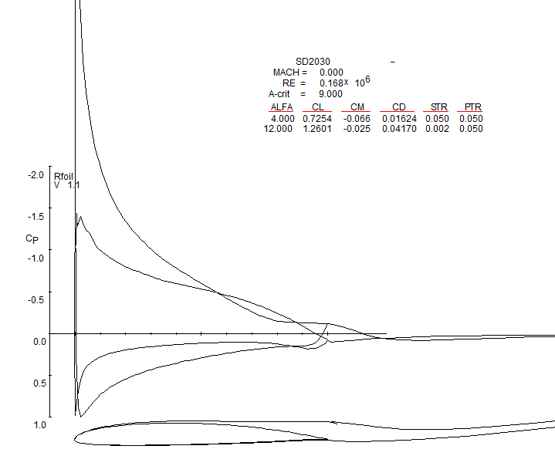
Test Considerations for Stall Delay
SD2030 Cp_{min} Range : -1.44 to -6.0 (no stall delay predicted close to rotor tip)
Max tow speed without cavitation (TSR=8, 1m depth): 1.5 m/s
1/25th Scale Rotor 1.8m Re#: 591,000
Largest Feasible Rotor 5.0m Re#: 1,623,000
May be worthwhile investigating the value of a test at Re# > 500k utilizing full-scale hydrofoils with BL trips to approximate full-scale performance.
Large discrepancy in Re# would make accuracy of results highly questionable
Further development needs to be done to select or design thicker full-scale hydrofoils.

